Slide 1
A Toolkit for Exploring Argumentation Logic
Author – Giorgos Flourentzos
Supervisors – Krysia Broda, Francesca Toni
Second Marker – Claudia Schulz

Slide 2
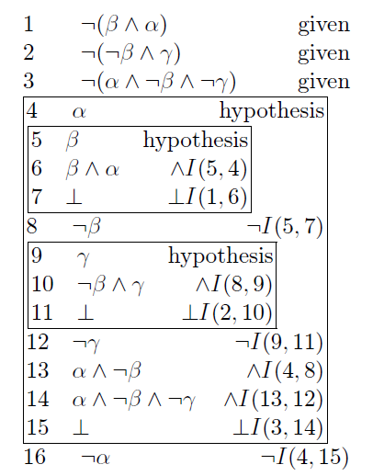
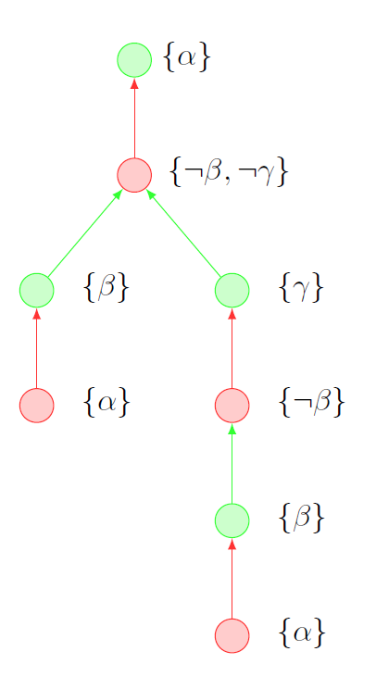
Elevator Pitch
Argumentation Logic

Slide 3
Argumentation Logic 101
Bridge between
Propositional Logic Natural Deduction
Argumentation Theory
Establishes analogy by defining properties and semantics and proving equivalences
Genuine Absurdity Property (GAP)
Non-Acceptability Semantics (NACC)
Aims to provide framework to deal with paraconsistent environments

Slide 4
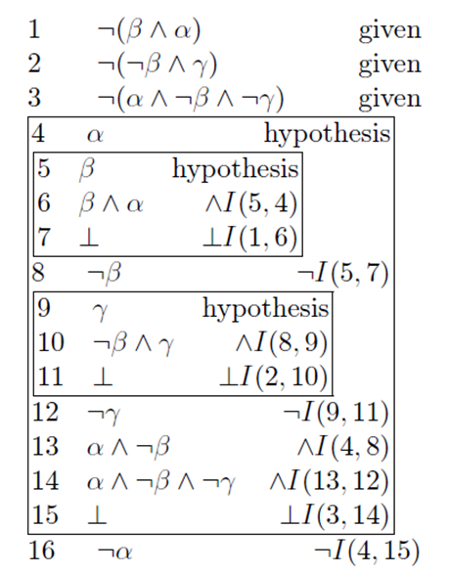
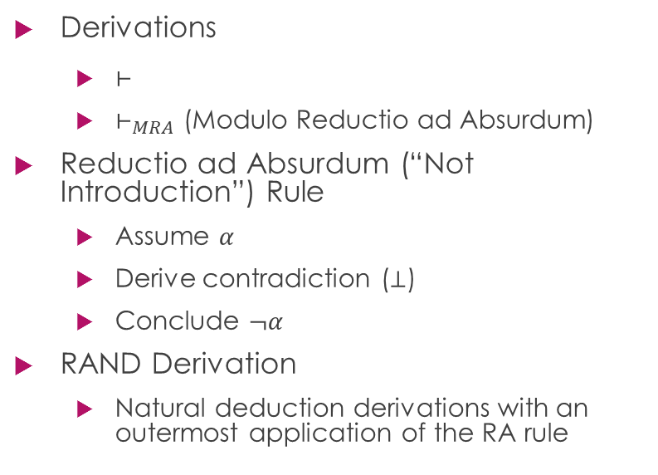
Propositional Logic Side
Derivations
$⊢$
$⊢_{MRA}$ (Modulo Reductio ad Absurdum)
Reductio ad Absurdum (“Not Introduction”) Rule
Assume $α$
Derive contradiction ($⊥$)
Conclude $¬α$
RAND Derivation
Natural deduction derivations with an outermost application of the RA rule

Slide 5
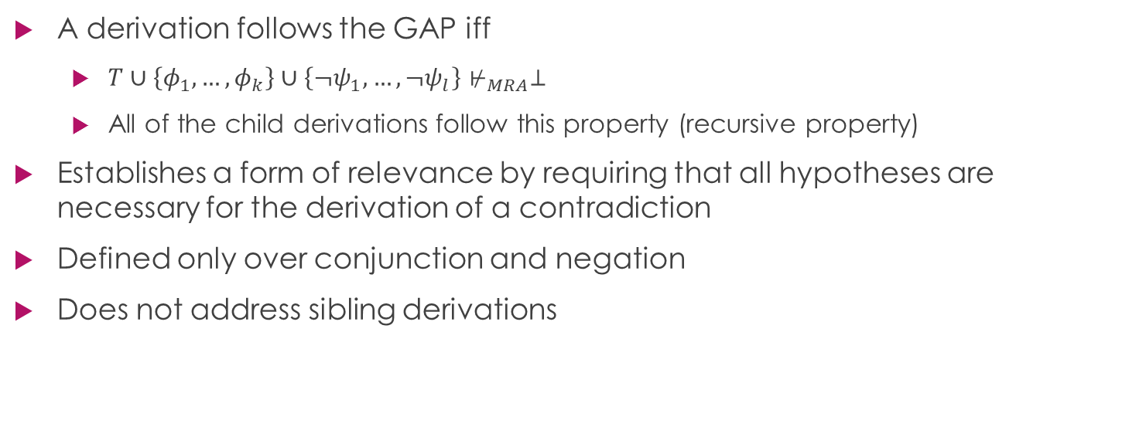
Genuine Absurdity Property (GAP)
A derivation follows the GAP iff
$T∪\left\{φ_{1},…,φ_{k}\right\}∪\left\{¬ψ_{1},…,¬ψ_{l}\right\}⊬_{MRA}⊥$
All of the child derivations follow this property (recursive property)
Establishes a form of relevance by requiring that all hypotheses are necessary for the derivation of a contradiction
Defined only over conjunction and negation
Does not address sibling derivations

Slide 6
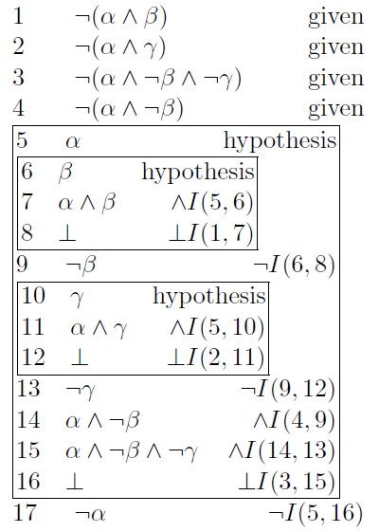
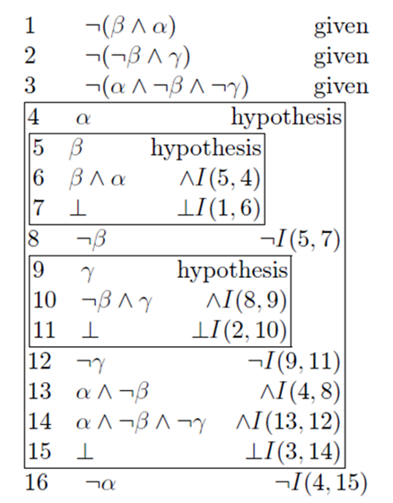
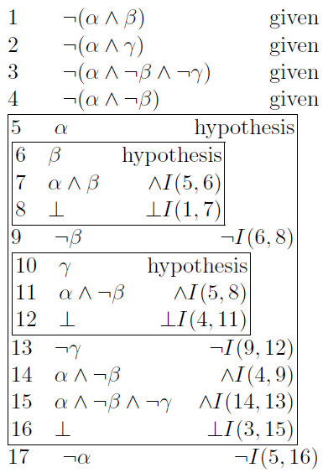
Genuine Absurdity Property Examples
Classic GAP
Extended GAP
Not GAP
unnecessary

Slide 7
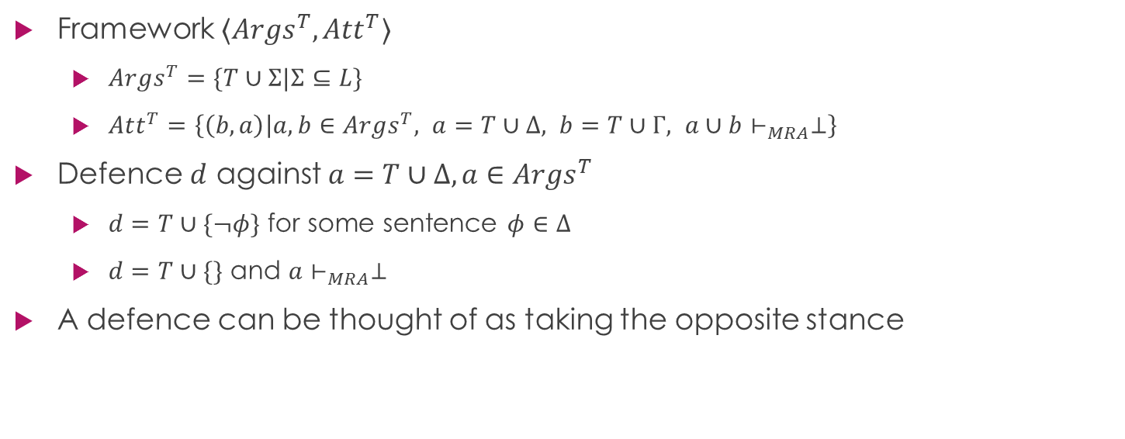
Argumentation Theory Side
Framework $〈Args^{T},Att^{T}〉$
$Args^{T}=\{T∪Σ|Σ⊆L\}$
$Att^{T}=\left\{\left(b,a\right) | a,b∈Args^{T}, a=T∪Δ, b=T∪Γ, a∪b⊢_{MRA}⊥\right\}$
Defence $d$ against $a=T∪Δ, a∈Args^{T}$
$d=T∪\{¬φ\}$ for some sentence $φ∈Δ$
$d=T∪\{\}$ and $a⊢_{MRA}⊥$
A defence can be thought of as taking the opposite stance

Slide 8

Non-Acceptability Semantics (NACC)
$NACC^{T}(a,a_{0})$ iff
$a⊈a_{0}$ and
$∃b∈Args^{T}, \left(b,a\right)∈Att^{T}$
$b⊆a_{0}∪a$ or
$∀d∈Args^{T}$ such that $d$ defends against $b$, $NACC^{T}(d, a∪a_{0})$

Slide 9
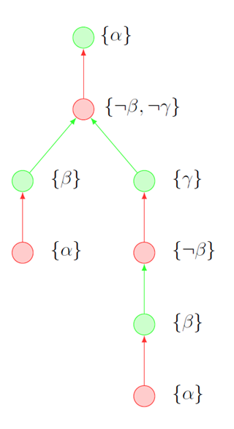

Non-Acceptability Semantics Example
Assume theory
$\{¬\left(β∧α\right), ¬\left(¬β∧γ\right), ¬\left(α∧¬β∧¬γ\right)\}$
We will try to prove the non-acceptability of $α$

Slide 10
The Point of it All
GAP ↔ NACC (for consistent theories)

Slide 11
Argumentation Logic Toolkit – Plan
Step 1: Generic Theorem Prover
Step 2: Theorem Prover fit for purpose
Step 3: Genuine Absurdity Property check
Step 4: Visualize GAP Proofs
Step 5: Convert non-GAP to GAP Proofs
Step 6: Introduce Disjunction and Implication
Step 7: Venture into Paraconsistency

Slide 12
Argumentation Logic Toolkit – Plan
Step 1: Generic Theorem Prover
Step 2: Theorem Prover fit for purpose
Step 3: Genuine Absurdity Property check
Step 4: Visualize GAP Proofs
Step 5: Convert non-GAP to GAP Proofs
Step 6: Introduce Disjunction and Implication
Step 7: Venture into Paraconsistency
Step 1+: Proof Builder
Step 3+: Extended Genuine Absurdity Property
Step 4+: Extract Proofs from Arguments
Step 4++: Argument Builder

Slide 13
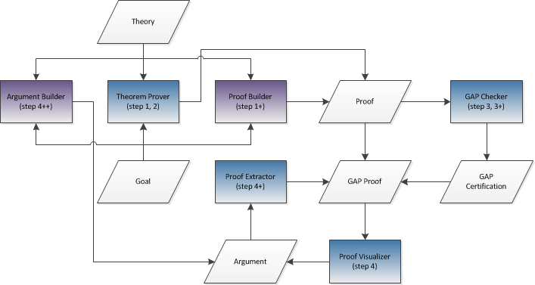
Flowchart

Slide 14
Solution Architecture
Core (Prolog)
All the steps discussed previously as algorithm implementations
Server (Prolog!)
Loads Core
Serves Client HTML/JS/CSS files
Responds requests from Client
Client (HTML/JS/CSS)
Provides useful GUI for Core

Slide 15
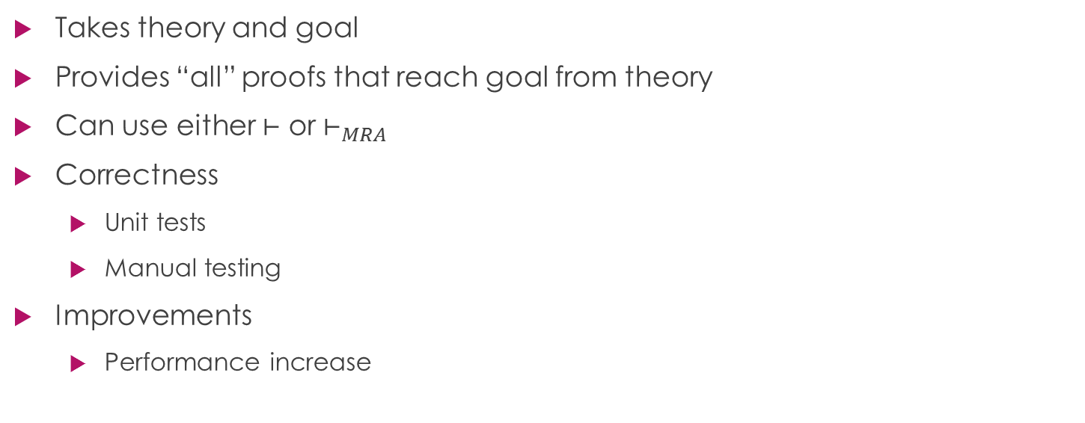
Step 1&2: Theorem Prover
Takes theory and goal
Provides “all” proofs that reach goal from theory
Can use either $⊢$ or $⊢_{MRA}$
Correctness
Unit tests
Manual testing
Improvements
Performance increase

Slide 16
Step 1+: Proof Builder
Allows the user to manually input a proof
Provides parser and checker that point out mistakes
Correctness
Manual testing

Slide 17
Step 3: GAP Check
Takes a proof as input
Uses theorem prover to check whether the proof follows the GAP
Performance dependent on theorem prover
Correctness
Unit testing
Manual testing

Slide 18
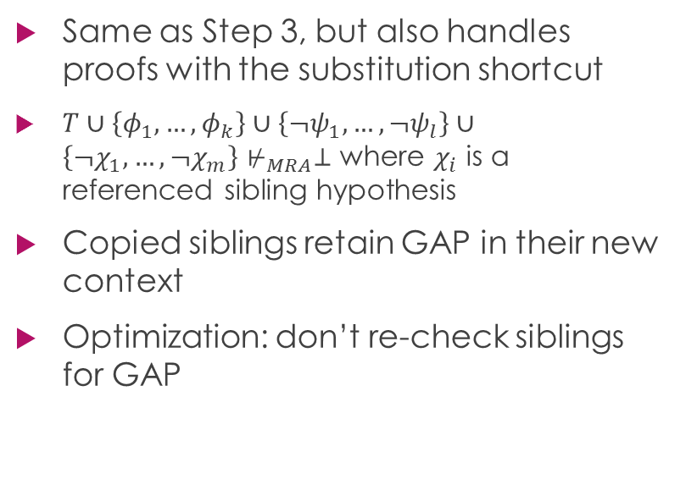
Step 3+: Extended GAP Check
Same as Step 3, but also handles proofs with the substitution shortcut
$T∪\left\{φ_{1},…,φ_{k}\right\}∪\left\{¬ψ_{1},…,¬ψ_{l}\right\}∪\left\{¬χ_{1},…,¬χ_{m}\right\}⊬_{MRA}⊥$ where $χ_{i}$ is a referenced sibling hypothesis
Copied siblings retain GAP in their new context
Optimization: don’t re-check siblings for GAP

Slide 19
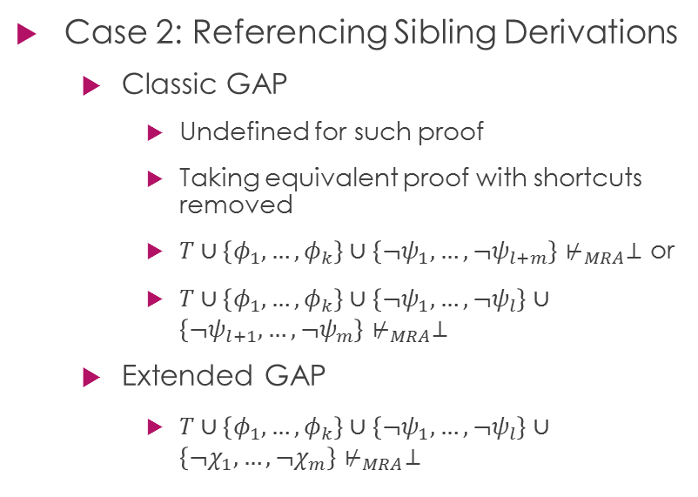
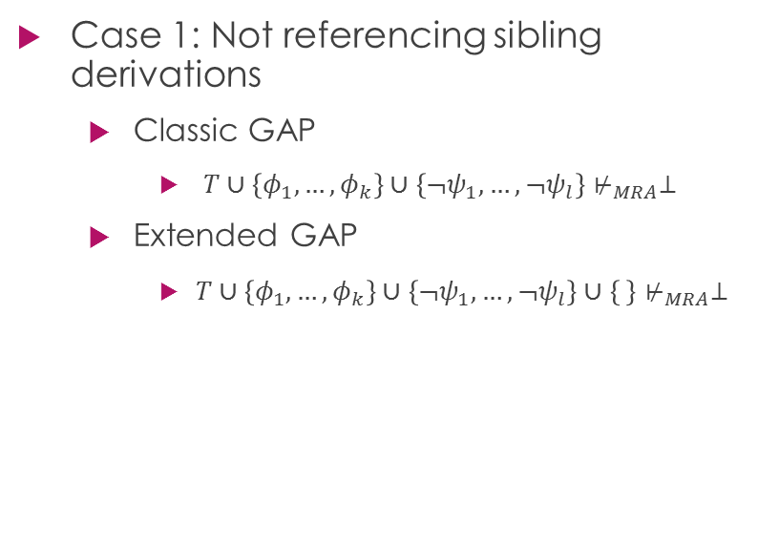
Extended GAP Check Proof Sketch
Case 1: Not referencing sibling derivations
Classic GAP
$T∪\left\{φ_{1},…,φ_{k}\right\}∪\left\{¬ψ_{1},…,¬ψ_{l}\right\}⊬_{MRA}⊥$
Extended GAP
$T∪\left\{φ_{1},…,φ_{k}\right\}∪\left\{¬ψ_{1},…,¬ψ_{l}\right\}∪\left\{ \right\}⊬_{MRA}⊥$
Case 2: Referencing Sibling Derivations
Classic GAP
Undefined for such proof
Taking equivalent proof with shortcuts removed
$T∪\left\{φ_{1},…,φ_{k}\right\}∪\left\{¬ψ_{1},…,¬ψ_{l+m}\right\}⊬_{MRA}⊥$ or
$T∪\left\{φ_{1},…,φ_{k}\right\}∪\left\{¬ψ_{1},…,¬ψ_{l}\right\}∪\left\{¬ψ_{l+1},…,¬ψ_{m}\right\}⊬_{MRA}⊥$
Extended GAP
$T∪\left\{φ_{1},…,φ_{k}\right\}∪\left\{¬ψ_{1},…,¬ψ_{l}\right\}∪\left\{¬χ_{1},…,¬χ_{m}\right\}⊬_{MRA}⊥$

Slide 20
Step 4: Visualizing GAP Proofs
Mapping
Hypothesis ↔ Defence
Contradiction ↔ Attack
Eliminates shortcuts by ironing out proofs when converting to arguments
Correctness
Looks great after 3 glasses of wine
Manual testing
Future work
Option to retain information on shortcuts

Slide 21
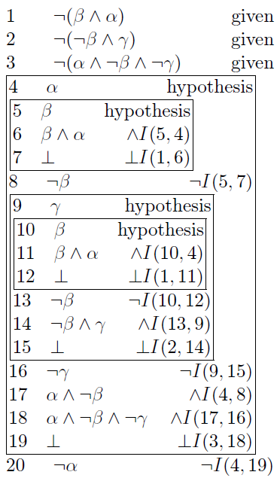
Step 4+: Extract Proofs from Arguments
Acts as inverse of Step 4
Makes use of established mapping
Uses theorem prover to build proofs
Guides theorem prover by building proofs bottom up
Correctness
Manual testing
Future work
Identify common subtrees and produce shortcuts

Slide 22
Step 4++: Argument Builder
Complements Proof Builder
Allows construction of arguments following NACC
Plays like a mini-game between user (opponent) and computer (proponent)
Uses theorem prover to check attacks suggested by user
Allows an argument data entry point to the system
Correctness
Manual testing

Slide 23
Complete Ecosystem
Proof
Step 1&2: Theorem Prover
Step 1+: Proof Builder
Step 3(+): GAP Check
GAP Proof
Step 4: Visualizer
Argument
Step 4++: Argument Builder
Step 4+: Proof Extractor

Slide 24
Contributions
Built toolkit to aid exploration of Argumentation Logic which contains
Theorem prover
Proof builder
(Extended) GAP checker
Visualizer and extractor
Argument builder
Graphical User Interface
Extended the Genuine Absurdity Property to handle proofs with shortcuts
Devised an algorithm for converting GAP proofs to arguments
Devised an algorithm for converting arguments to proofs

Slide 25
Future Work
Improve theorem prover
Convert non-GAP proofs to GAP (Step 5)
Re-introduce disjunction (Step 6)
Look into paraconsistency (Step 7) and extend toolkit to handle it

Slide 26
Thank you for watching!
I will happily answer any questions you may have!
Many thanks to
Dr. Krysia Broda
Dr. Francesca Toni
Claudia Schulz
Professor Antonis C. Kakas

Slide 27
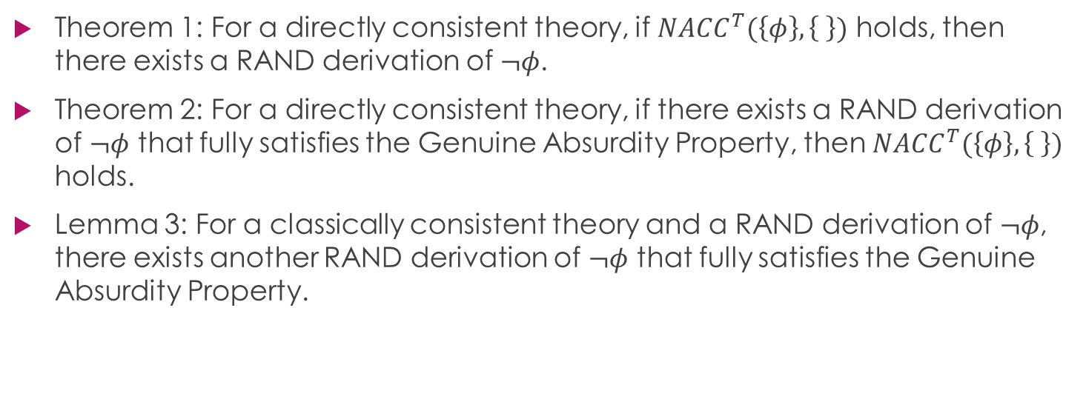
Some Theorems and Lemmas
Theorem 1: For a directly consistent theory, if $NACC^{T}(\left\{φ\right\},\left\{ \right\})$ holds, then there exists a RAND derivation of $¬φ$.
Theorem 2: For a directly consistent theory, if there exists a RAND derivation of $¬φ$ that fully satisfies the Genuine Absurdity Property, then $NACC^{T}(\left\{φ\right\},\left\{ \right\})$ holds.
Lemma 3: For a classically consistent theory and a RAND derivation of $¬φ$, there exists another RAND derivation of $¬φ$ that fully satisfies the Genuine Absurdity Property.

